Slide 1



Sale Report
View in Power BI
Last data refresh:
3/13/2023 4:55:35 PM UTC
Downloaded at:
3/13/2023 6:24:25 PM UTC

Slide 2
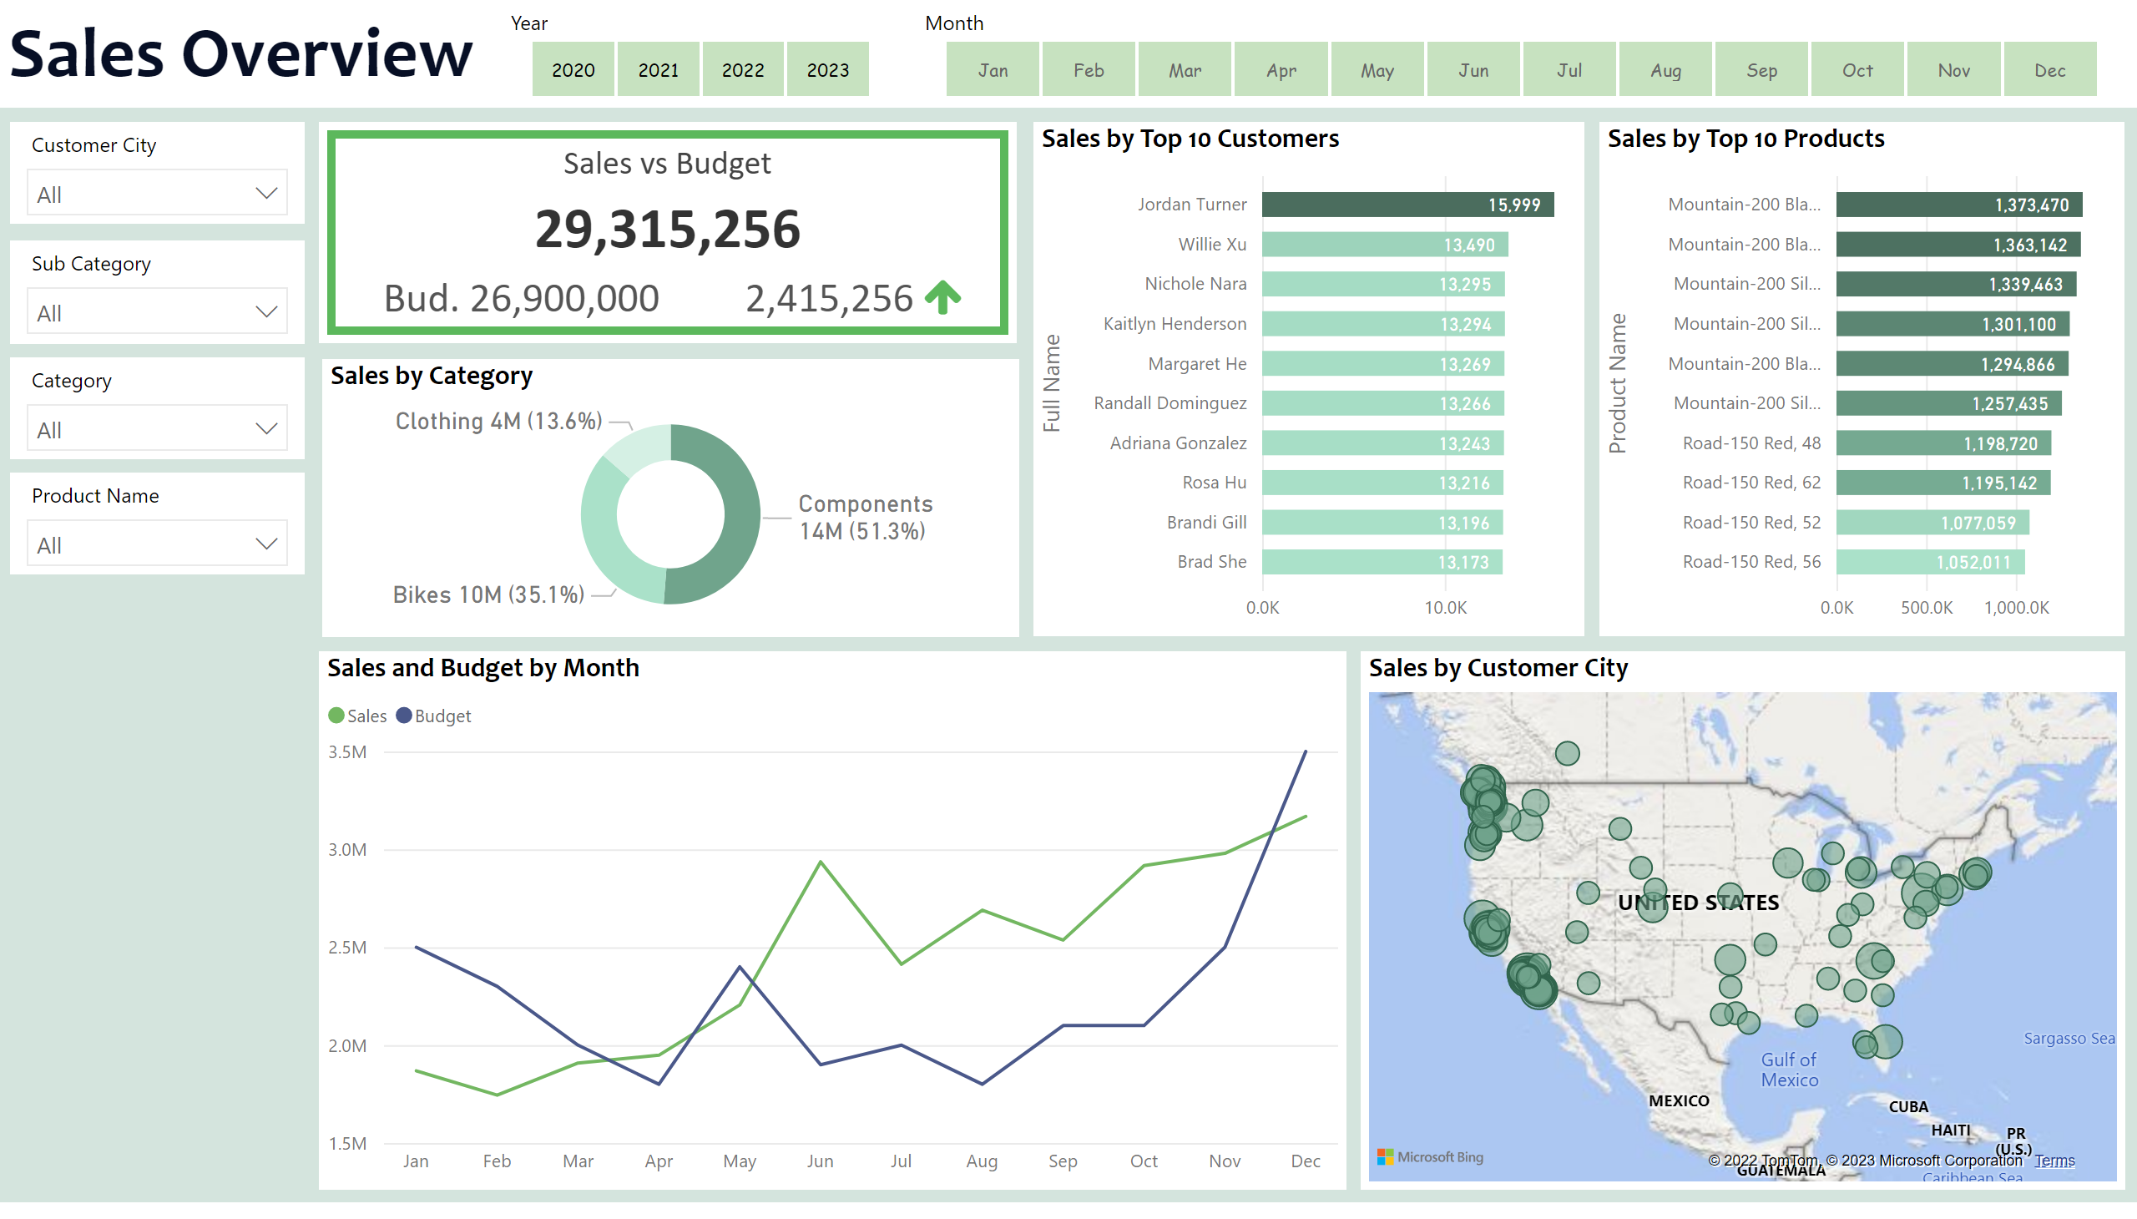
Sales Overview
Notes:
donutChart
No alt text provided
textbox
No alt text provided
slicer
No alt text provided
slicer
No alt text provided
slicer
No alt text provided
slicer
No alt text provided
slicer
No alt text provided
slicer
No alt text provided
BBED0A4D4D8D44CE93CF2DAFADEE466C
No alt text provided
lineChart
No alt text provided
Sales by Top 10 Customers
No alt text provided
Sales by Top 10 Products
No alt text provided
map
No alt text provided

Slide 3
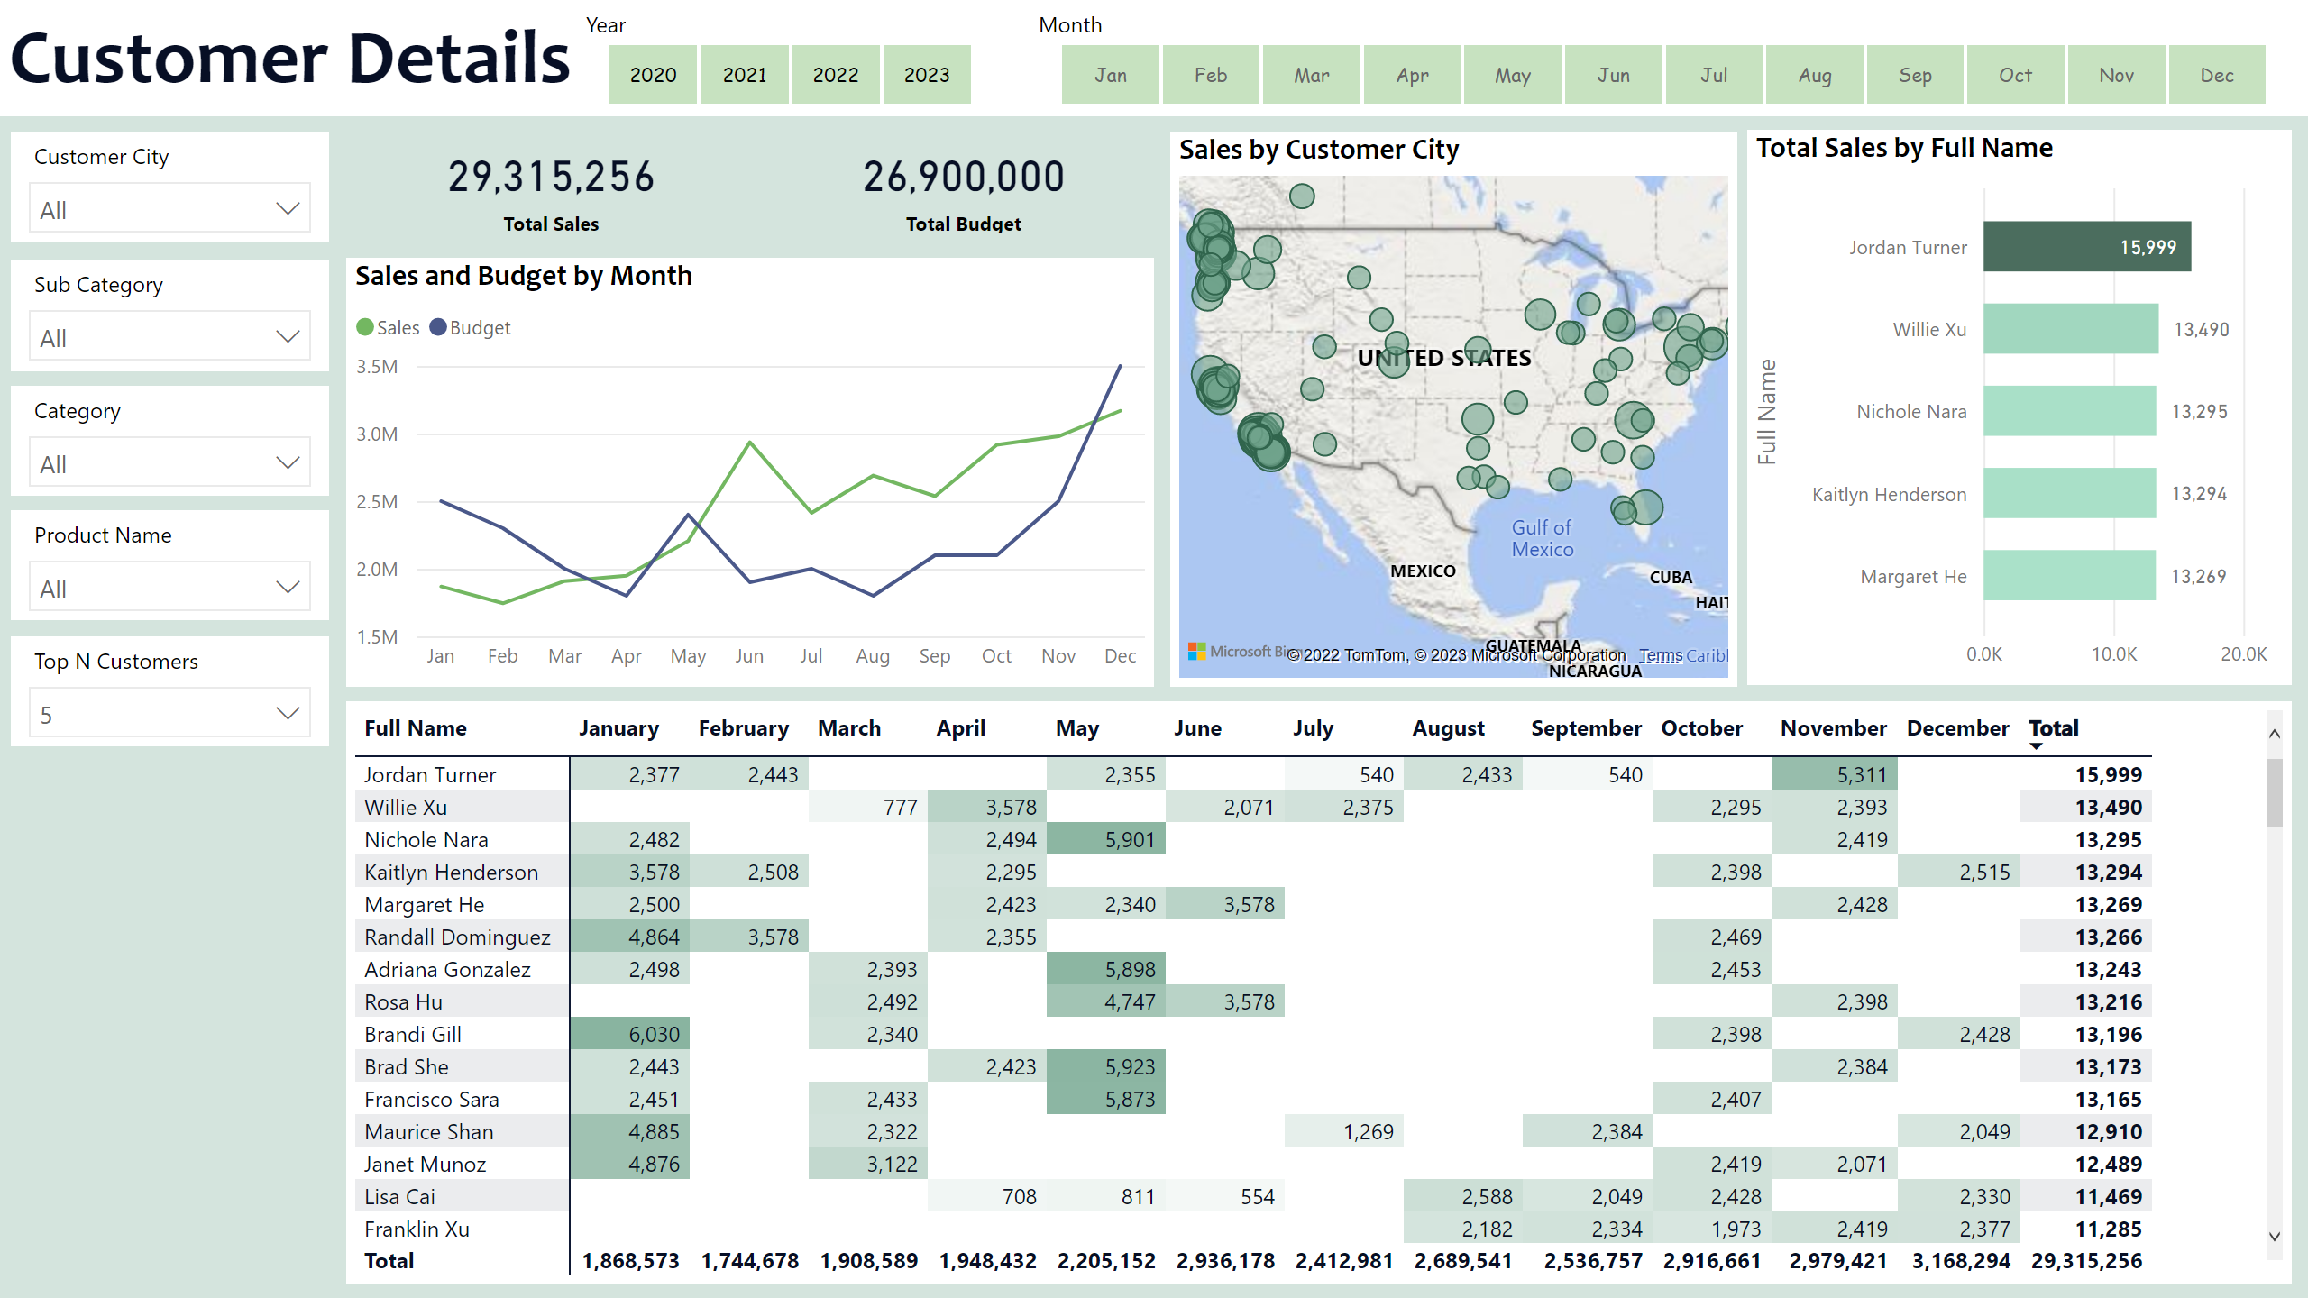
Customer Details
Notes:
textbox
No alt text provided
slicer
No alt text provided
slicer
No alt text provided
slicer
No alt text provided
slicer
No alt text provided
slicer
No alt text provided
slicer
No alt text provided
lineChart
No alt text provided
card
No alt text provided
card
No alt text provided
map
No alt text provided
slicer
No alt text provided
clusteredBarChart
No alt text provided
pivotTable
No alt text provided

Slide 4
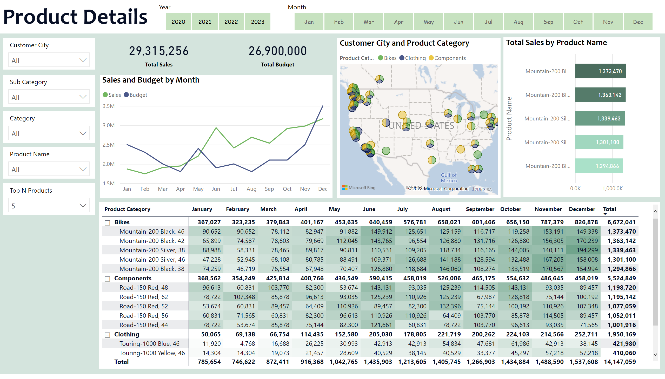
Product Details
Notes:
textbox
No alt text provided
slicer
No alt text provided
slicer
No alt text provided
slicer
No alt text provided
slicer
No alt text provided
slicer
No alt text provided
slicer
No alt text provided
pivotTable
No alt text provided
lineChart
No alt text provided
card
No alt text provided
card
No alt text provided
map
No alt text provided
slicer
No alt text provided
clusteredBarChart
No alt text provided

